Slide 1
Inheritance

Slide 2
INHERITANCE (Part 1)
Class Hierarchies
Extending Objects
Overriding Methods
abstract
extends
super
implements
interface

Slide 3
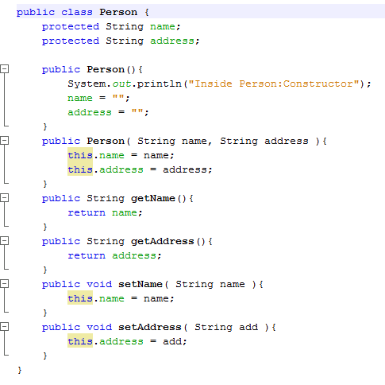

Slide 4
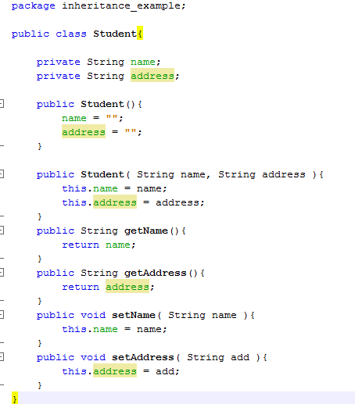

Slide 5
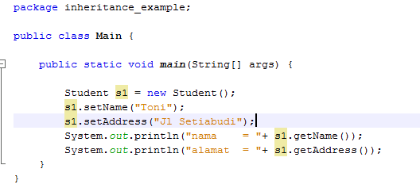
Main

Slide 6
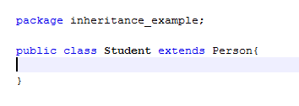
Penyederhanaan kelas student dgn meng-extends kelas person
kelas Student tampak ‘tidak punya’ method & atribut, kan ? ☺

Slide 7
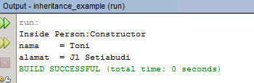
Main
Akan memanggil constructor Student()
Hasil pemanggilan constructor superclass (kelas Person)

Slide 8
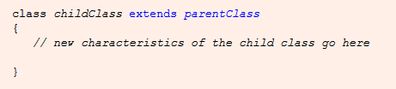
It’s called INHERITANCE

Slide 9
Inheritance
Inheritance models “is a” relationships
object “is an” other object if it can behave in the same way
inheritance uses similarities and differences to model groups of related objects

Slide 10
Inheritance is a way of:
organizing information
grouping similar classes
modeling similarities among classes
creating a taxonomy of objects

Slide 11
Inheritance
First, let’s discuss some important facts about inheritance…

Slide 12
Inheritance
Where there’s inheritance, there’s an Inheritance Hierarchy of classes
We can say:
Reptile, Mammal and Fish “inherit from” Animal
Dog, Cat, and Moose “inherit from” Mammal
Animal
Reptile
Mammal
Fish
Dog
Cat
Moose

Slide 13
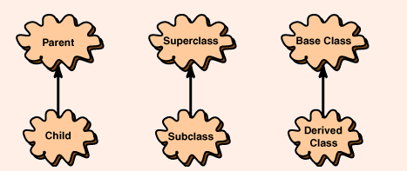

Slide 14
Superclasses and Subclasses
Animal is called superclass
or base class or parent class
in our car example, Vehicle is called superclass
Fish is called subclass
or derived class or child class
in our car example, SportsCar is subclass
Any class can be both at same time
e.g., Mammal is superclass of Moose and subclass of Animal
Can inherit from only one superclass in Java

Slide 15
Questions - 1
Apa yang diwariskan oleh superclass ke subclass –nya?

Slide 16
Inheriting Capabilities and Properties
Subclass inherits all public capabilities of its superclass
if Animals eat and sleep, then Reptiles, Mammals, and Fish eat and sleep
As a general pattern, subclasses:
inherit public capabilities (methods)
inherit private properties (instance variables)
only indirect access via inherited superclass methods that make use of them (pseudo inheritance)
Private → protected ??
Grrmm l…grrmm… maksudnya apa sih ? ☹

Slide 17
Question - 2
Apakah behaviour subclass HARUS mirip 100 % dengan behaviour superclass ?

Slide 18
Subclass specializes its superclass, by:
adding new methods,
overriding existing methods,
and defining “abstract” methods declared by parent that have no code in them → next lecture !!
Superclass factors out capabilities common among its subclasses
subclasses are defined by their differences from their superclass

Slide 19
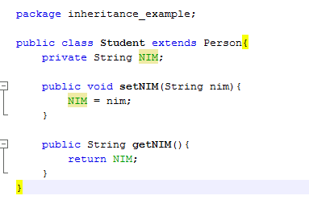
Adding new method
Menambahkan atribut NIM dan method setNIM() dan getNIM() pada kelas Student

Slide 20
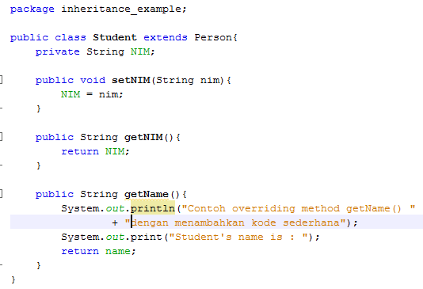
Overriding (Redefining) Methods
Method dgn nama sama namun behaviour berbeda
Partial overriding
Baris ini ditambahkan pada method getName() di kelas Student

Slide 21
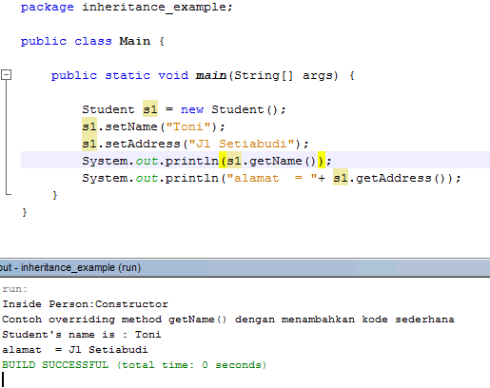
getName() yg dipanggil dari kelas mana ??
Dari kelas mana?

Slide 22
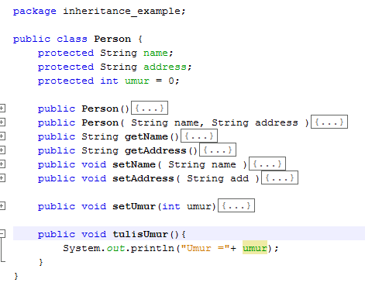
super () pada method
Pemanggilan method tulisUmur() ini akan menghasilkan apa?

Slide 23
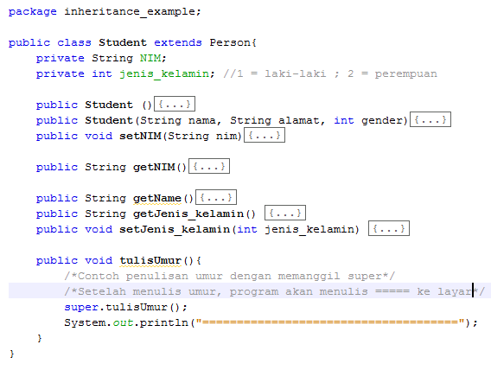
Pemanggilan method tulisUmur() ini akan menghasilkan apa?

Slide 24
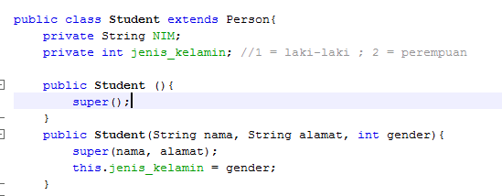
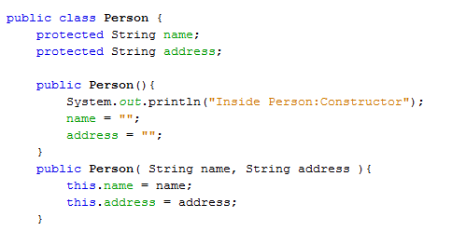
Super pada constructor
Memanggil constructor di superclass

Slide 25
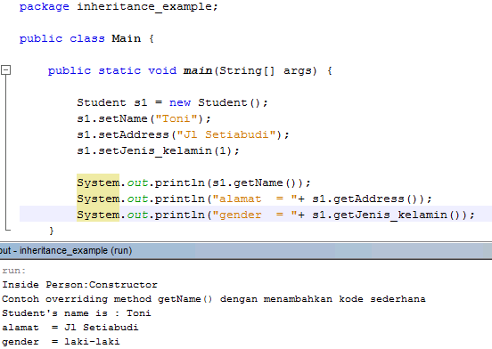
Contoh penggunaan

Slide 26
Question
Why is the statement that invokes the parent's constructor called super()?
Does a child constructor always invoke a parent constructor?

Slide 27
Method Resolution
First, Java checks to see if the instance’s class defines the method; if so, Java calls it
If not, Java “walks up the class inheritance tree” from subclass to superclass until it either:
finds method, in which case it calls the inherited method
doesn’t find method; this is a compile-time error (sending a message for which there is no method)
This process is called method resolution
move

Slide 28
Inheritance as Form of Abstraction
The root of a class hierarchy is the most general object, because it is the superclass to every other object in the hierarchy
can always say much more about how a subclass behaves than how its superclass behaves

Slide 29
5 things you might find in an Inheritance Hierarchy:
superclass is too general to declare all behavior, so each subclass adds its own behavior
2) superclass legislates an abstract behavior and therefore delegates implementation to its subclasses
superclass specifies behavior, subclasses inherit behavior
4) superclass specifies behavior, subclasses can choose to override behavior completely
just because a subclass inherits a method doesn’t
mean that it must act in the same way as its
superclass
subclass can choose to reject its superclass’ implementation of any method and “do it my way”
5) superclass specifies behavior, subclasses can choose to override behavior in part
called partial overriding

Slide 30
Exercise
Kelas Person
Atribut: nama, umur, alamat, jenis kelamin
Buat constructor untuk set nilai atribut
Buat method getter/accessor
Kelas Student extends Person
Atribut: ID, namaSMU, nilaiMath, nilaiBahasa, nilaiSains
Buat Constructor untuk set nilai atribut
Buat method getter/accessor
Buat method:
study () → System.out.println(“reading some books, doing exercises ”)
hitungRataNilai()
Override method:
getAlamat → menambahkan tulisan kota dan propinsi pada akhir penulisan alamat (contoh: [alamat]-Bandung- Jawa Barat)
Buat driver untuk mengetes kelas di atas (bebas)

Slide 31
Bagaimana membuat agar atribut/method di kelas Parent (superclass) tidak di-override di kelas Anak?

Slide 32
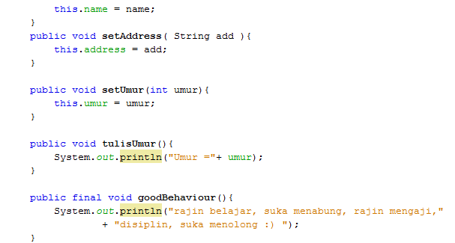
Final pada method

Slide 33
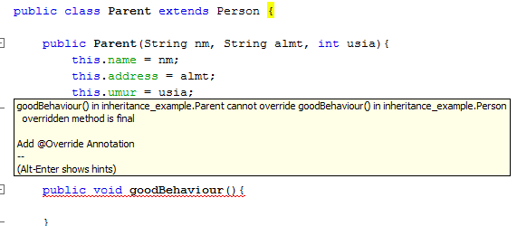
Method goodBehaviour() tidak bisa di-override di kelas Anak

Slide 34
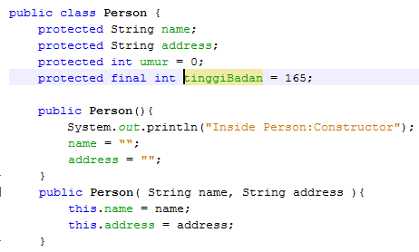
final pada atribut
Jadi konstanta lho…

Slide 35
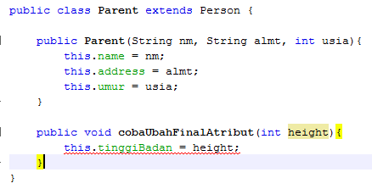
Atribut final tidak boleh diubah isinya lho…
Error: Cannot assign a value to final variable tinggiBadan

